Slide 1
WB Carbon Monitor Cities
Region Boundary and LCZ maps
C.Z., 2022-07-07

Slide 2
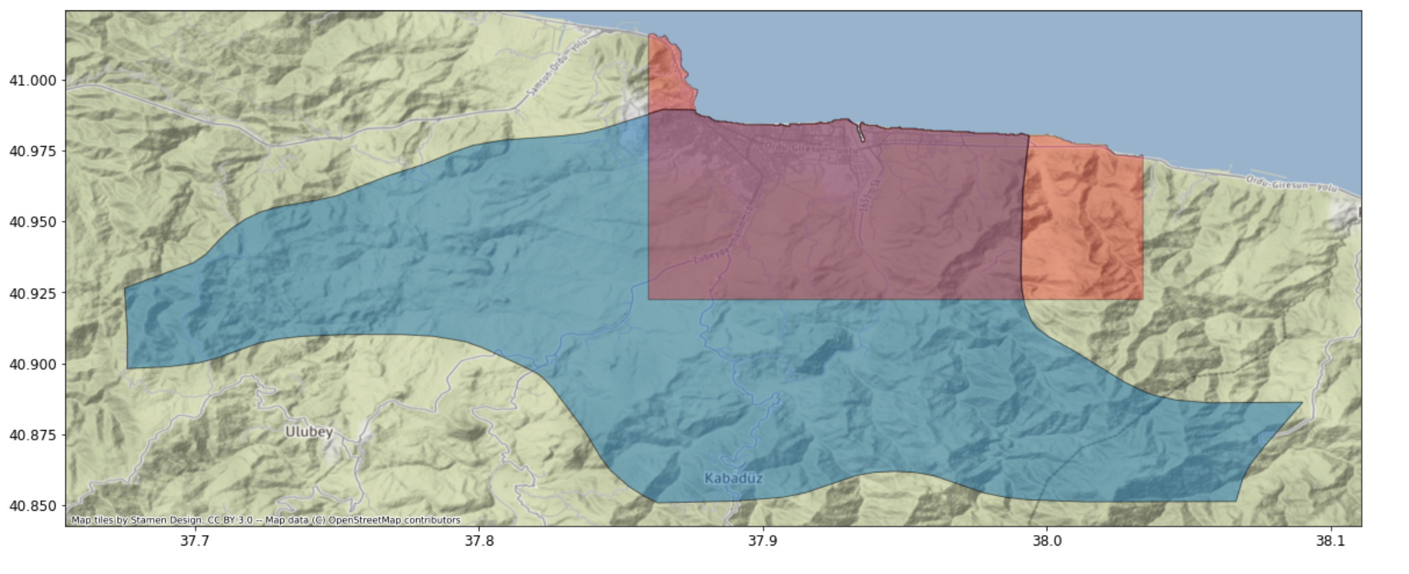
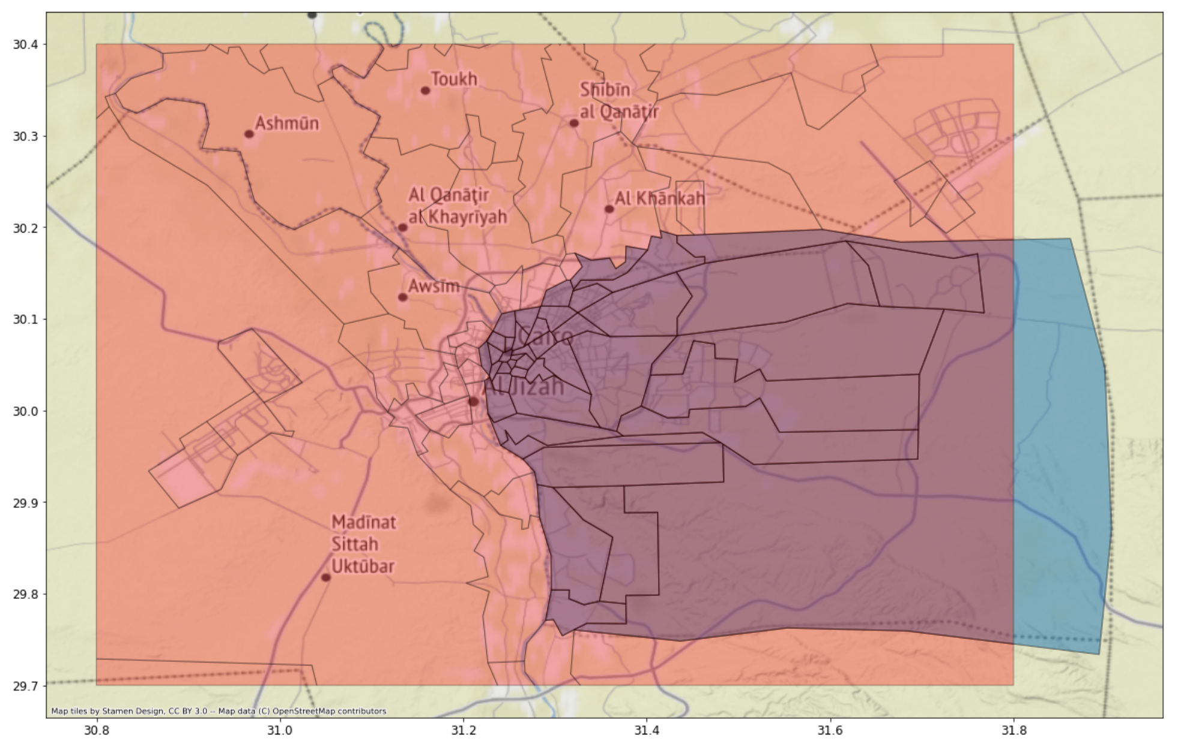
Use boxes as boundary- why
Administrative divisions include large non-urban areas (not of our interests)
Continuous urban areas are divide into parts by administrative division
Easier for analysis

Slide 3
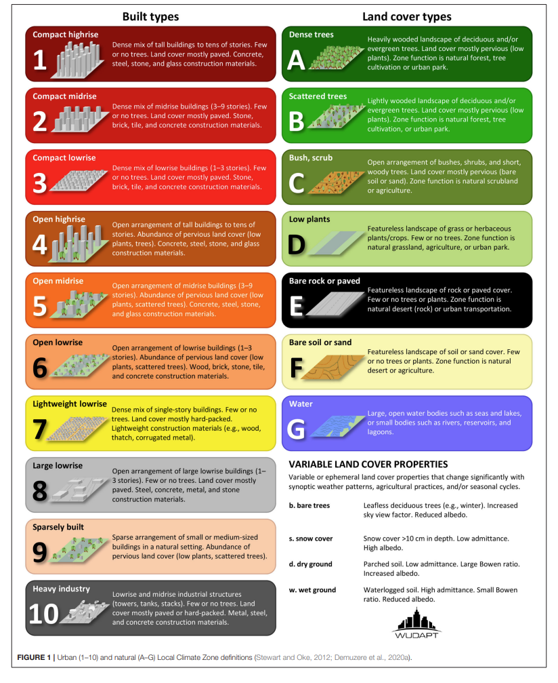

LCZ class and color scheme
Water
Sand
Rock
Low plants
Bush
Scatter trees
Dense trees
Industrial
Buildings in nature land cover
Large 1-3 stories
Dense 1 story
1-3 stories
3-9 stories
Over 10 stories
Dense 1-3 stories
Dense 3-9 stories
Dense over 10 stories

Slide 4
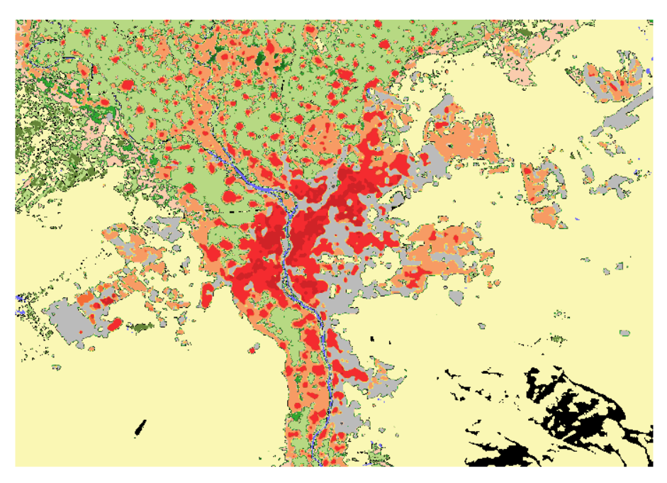
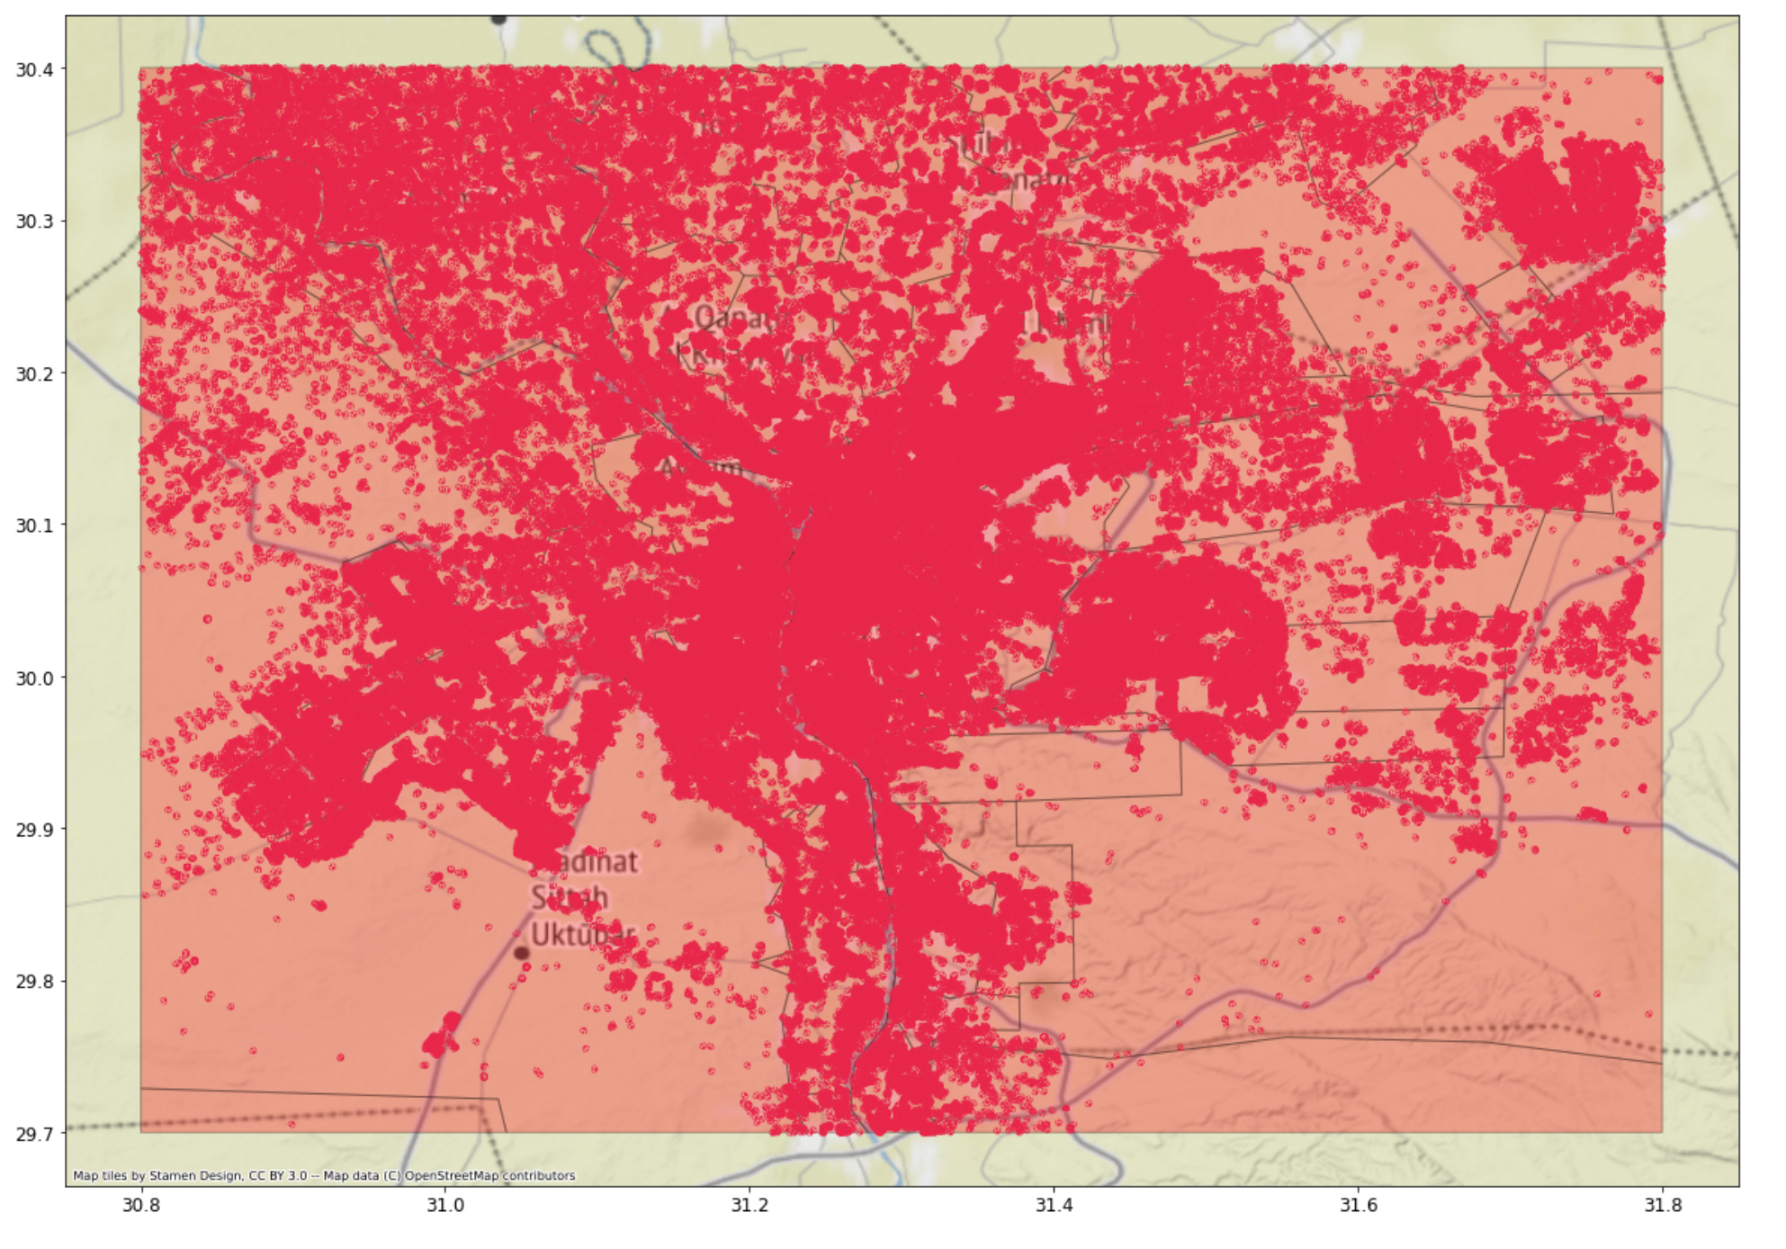
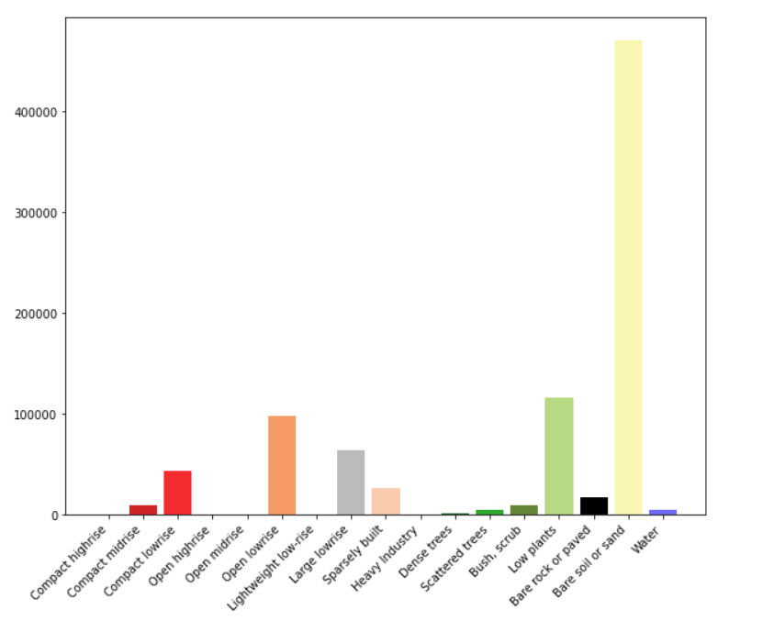
Use boxes as boundary- how
LCZ
Cairo
Microsoft buildings (10%)
Top left: (30.4, 30.8),
Bottom right:(29.7, 31.8)

Slide 5
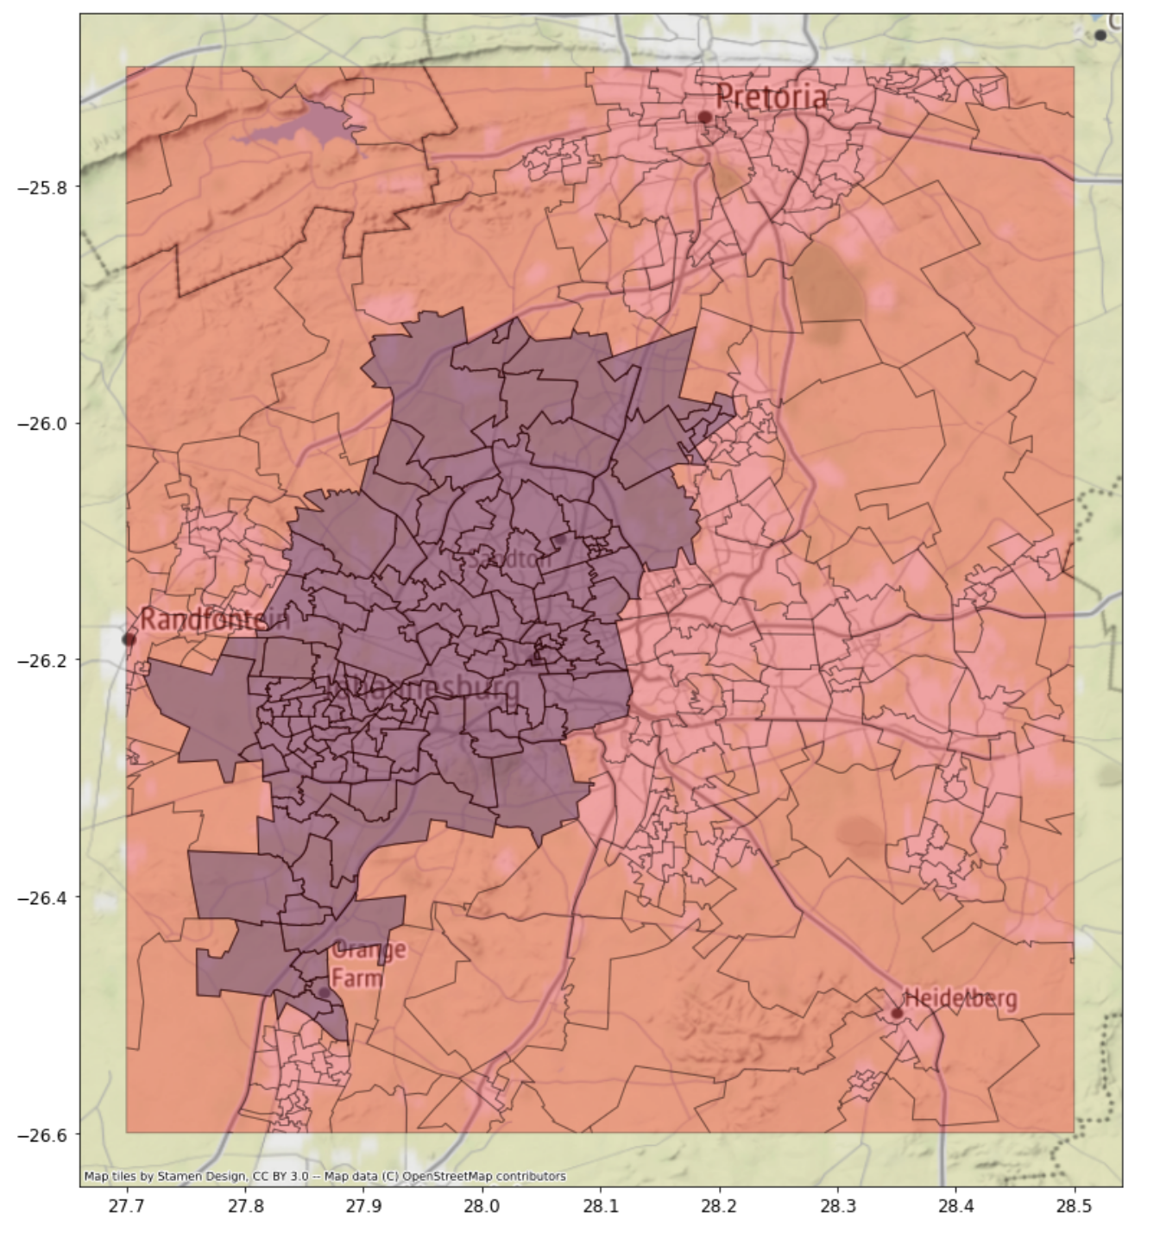
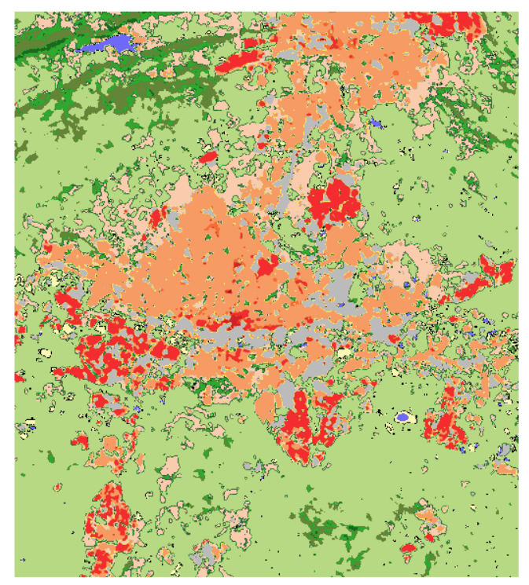
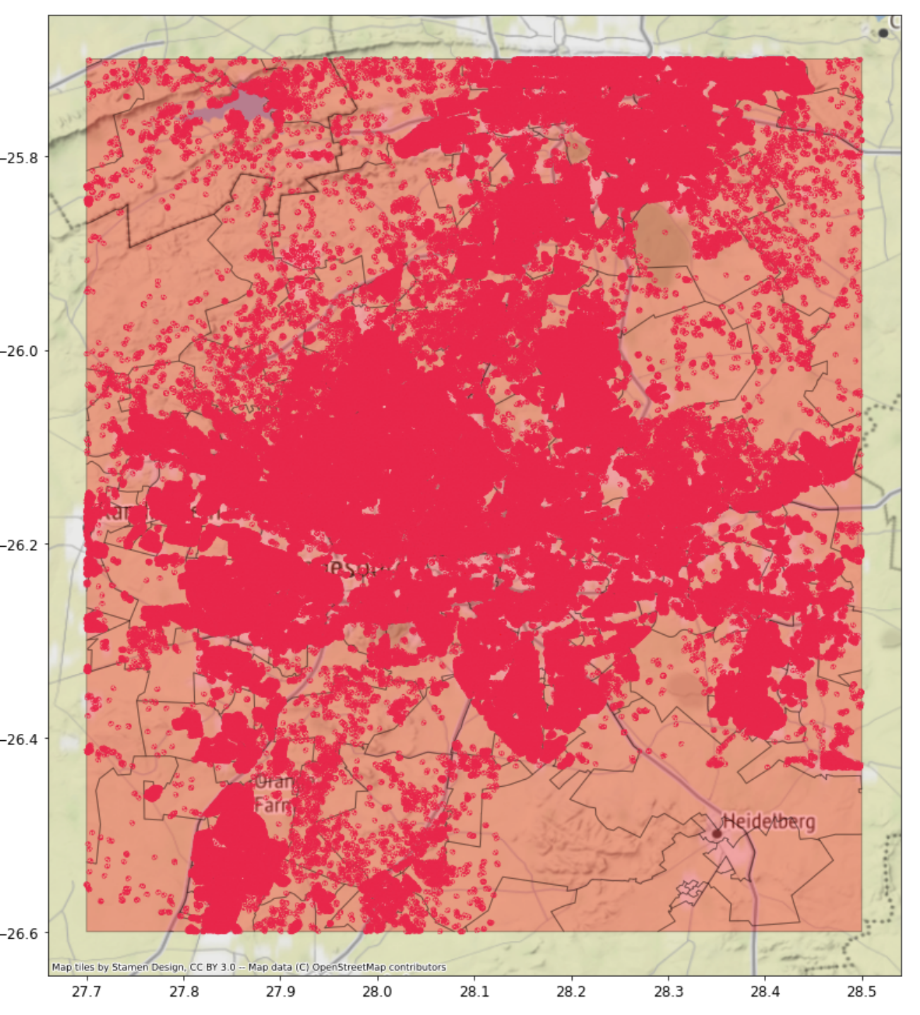
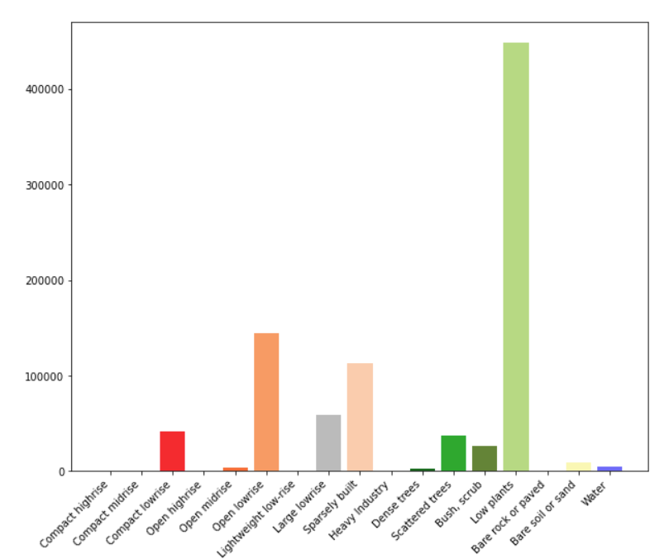
Johannesburg
(-25.7, 27.7),
(-26.6, 28.5)

Slide 6
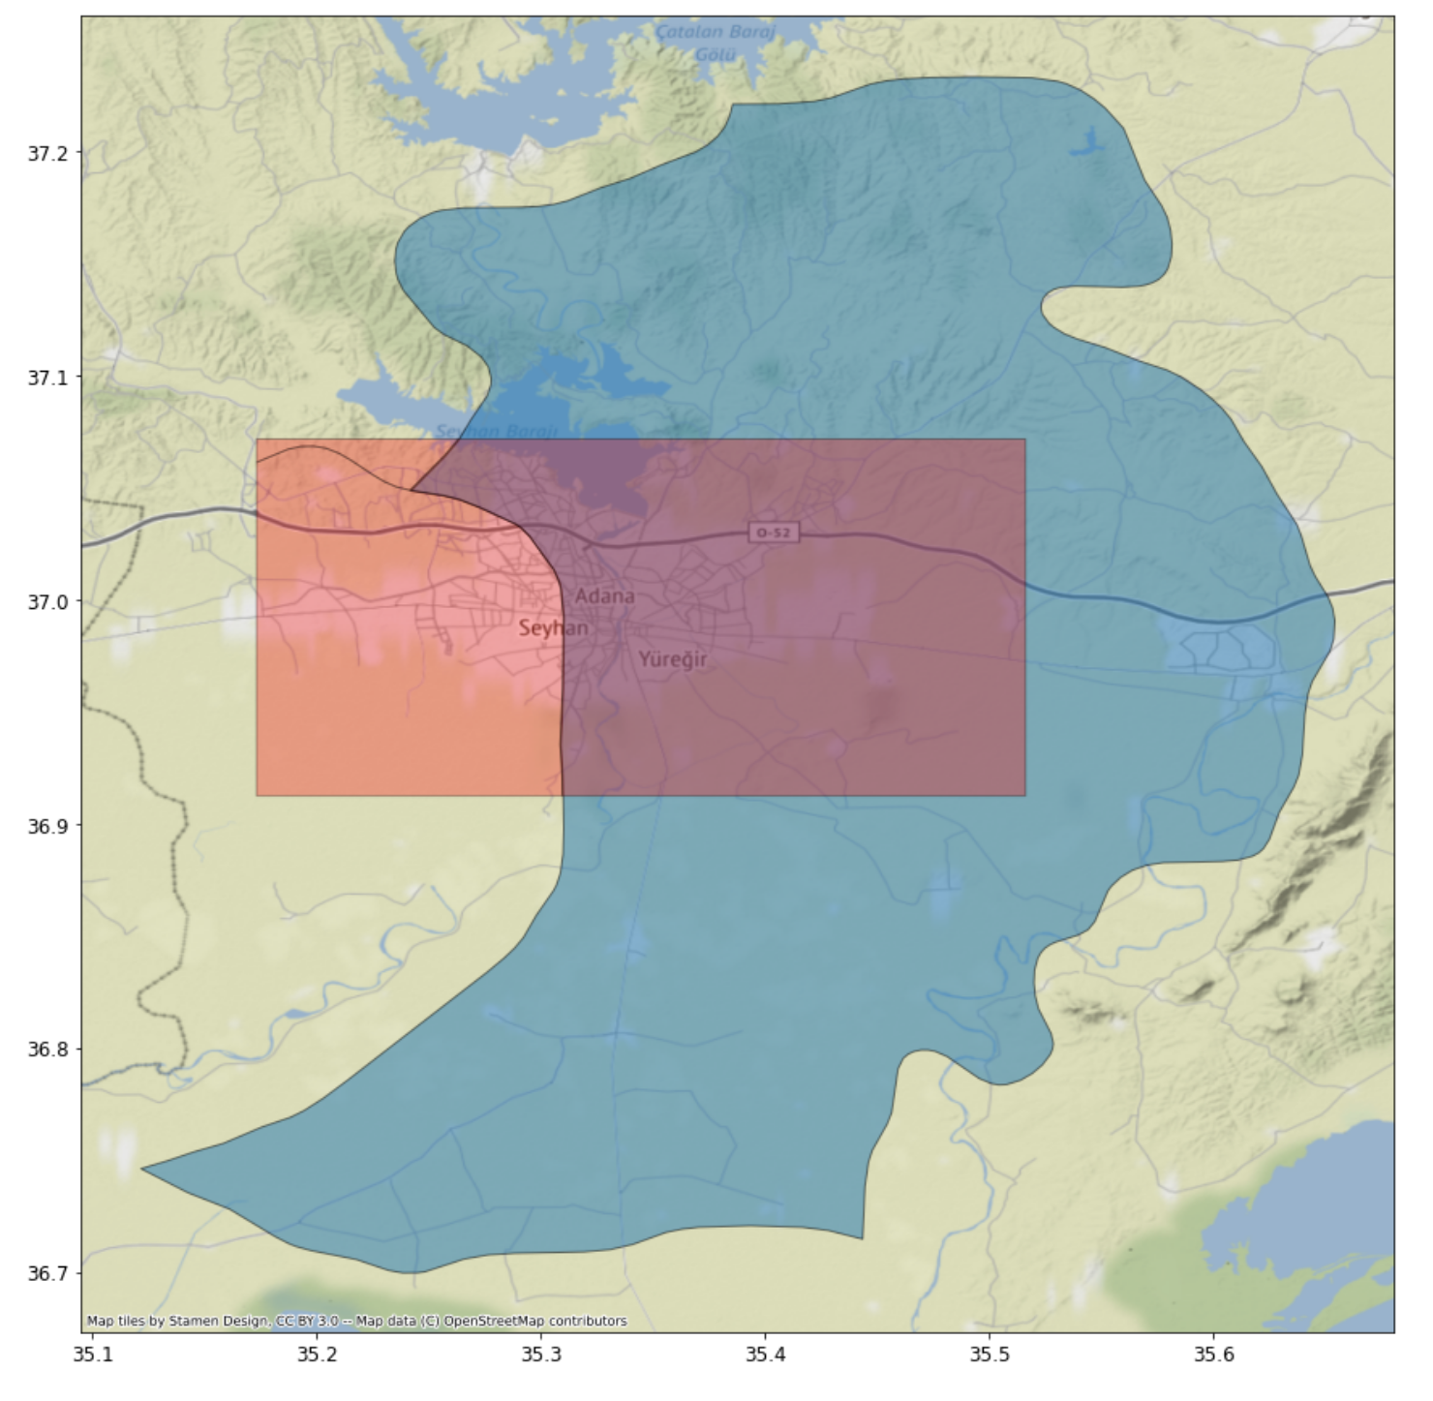
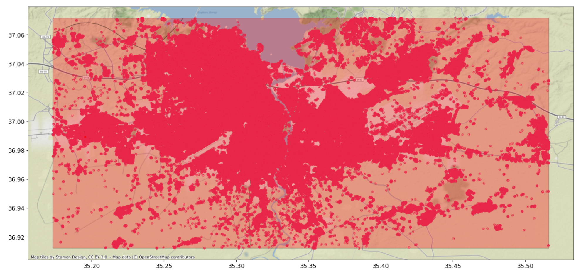
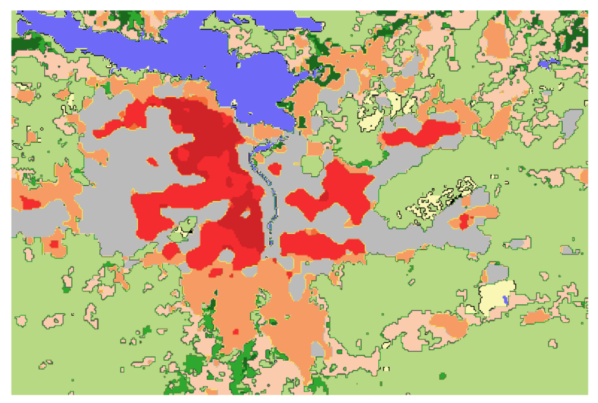
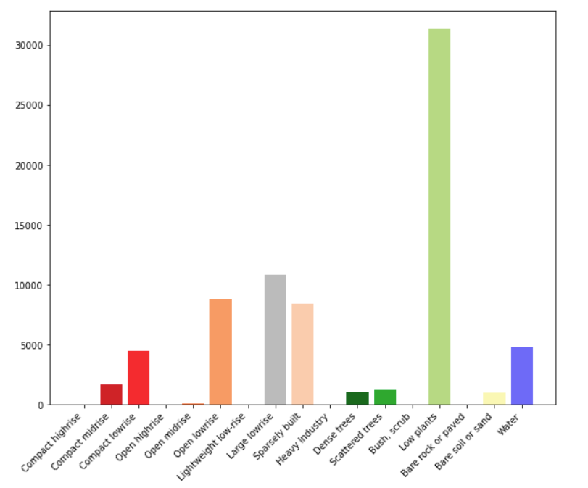
Adana
(37.1, 35.2),
(36.9, 35.5)

Slide 7
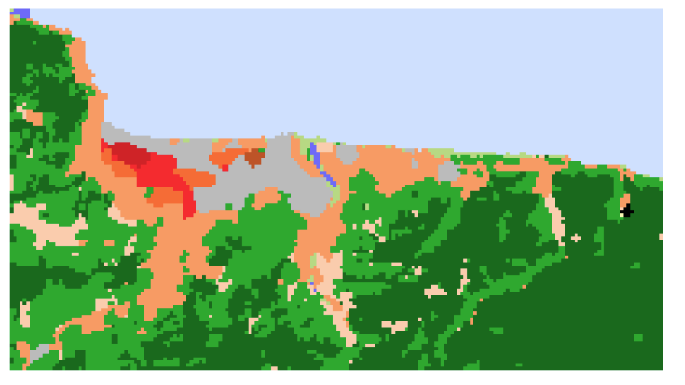
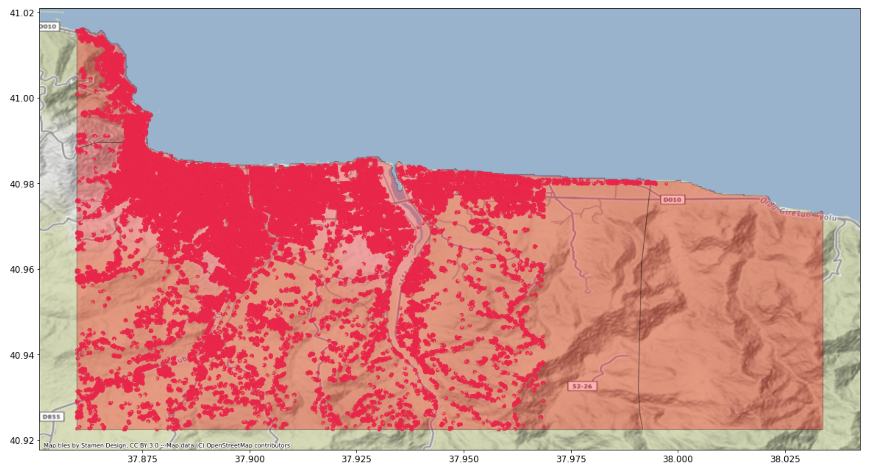
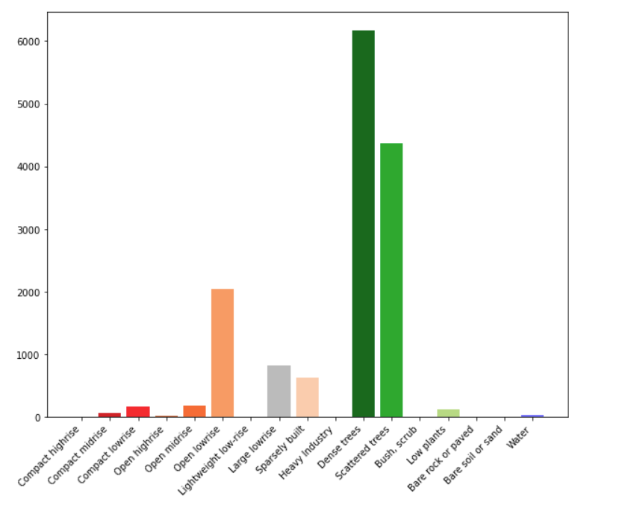
Ordu
(41.02, 37.85), (40.92, 38.03)

Slide 8
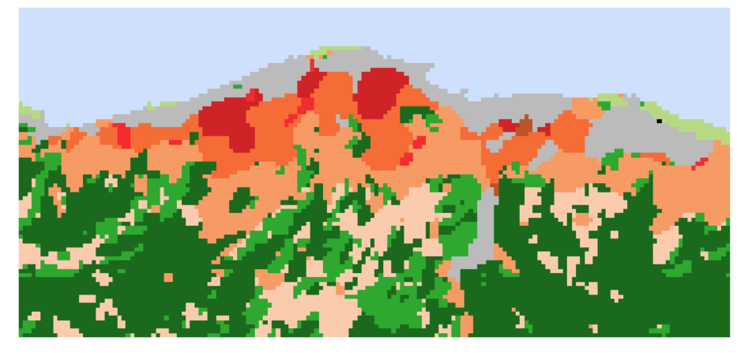
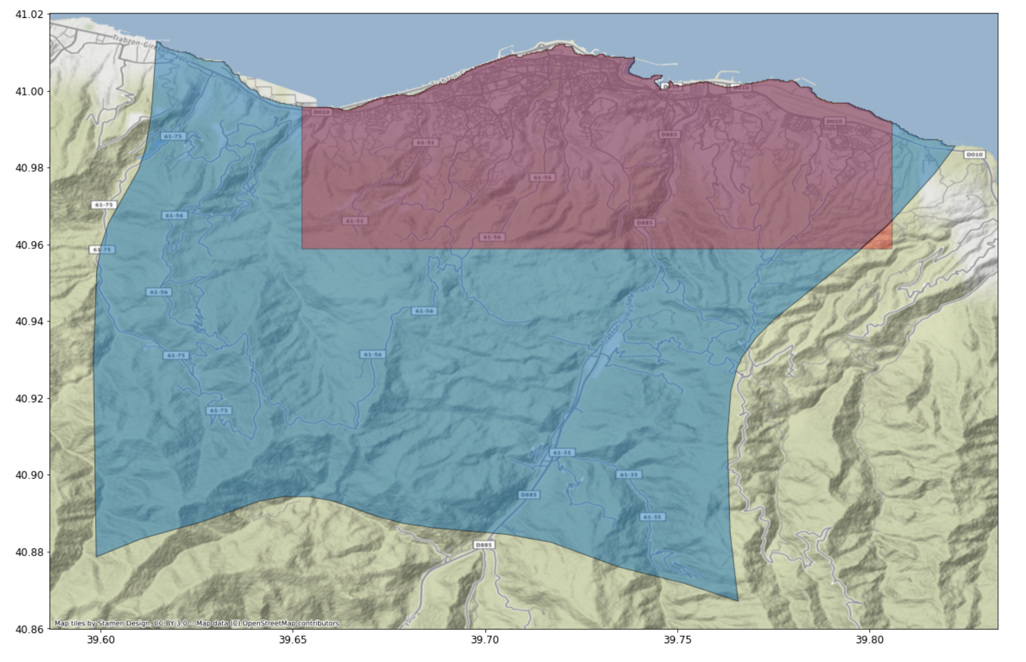
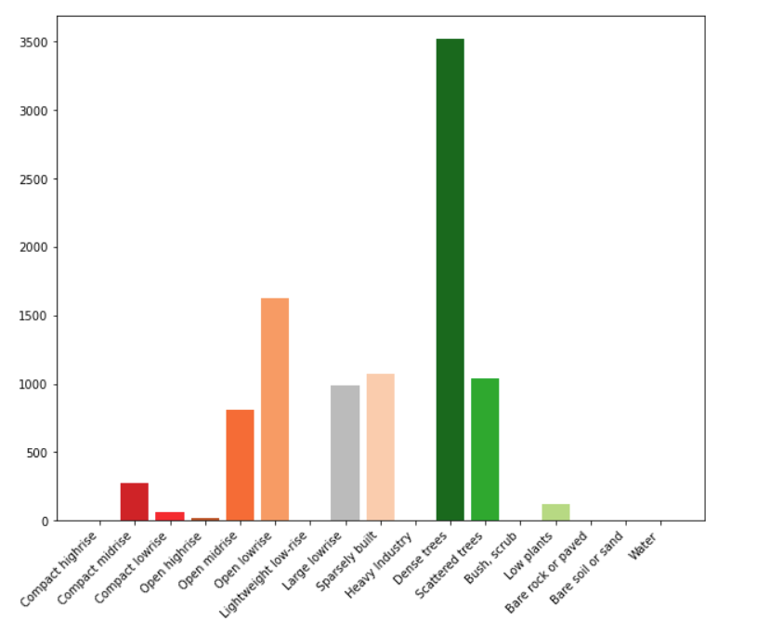
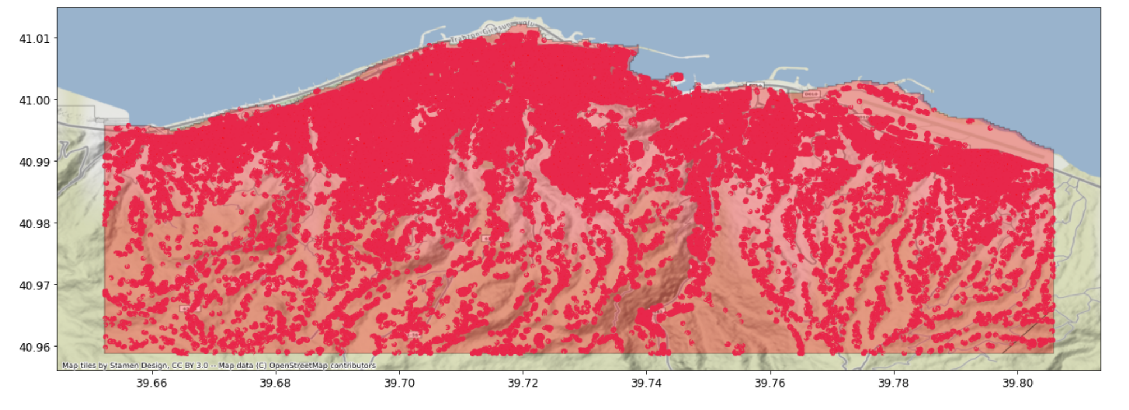
Trabzon
(41.02, 39.65),
(40.95, 39.80)

Slide 9
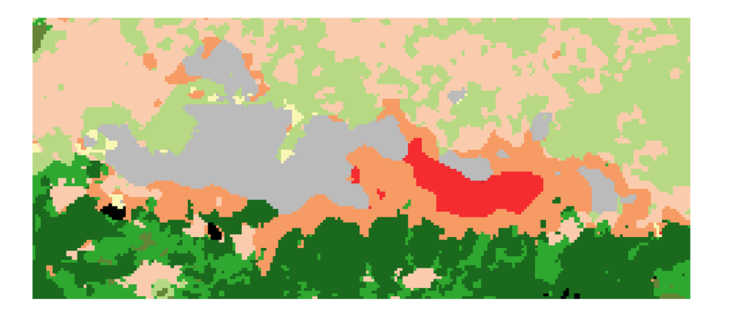
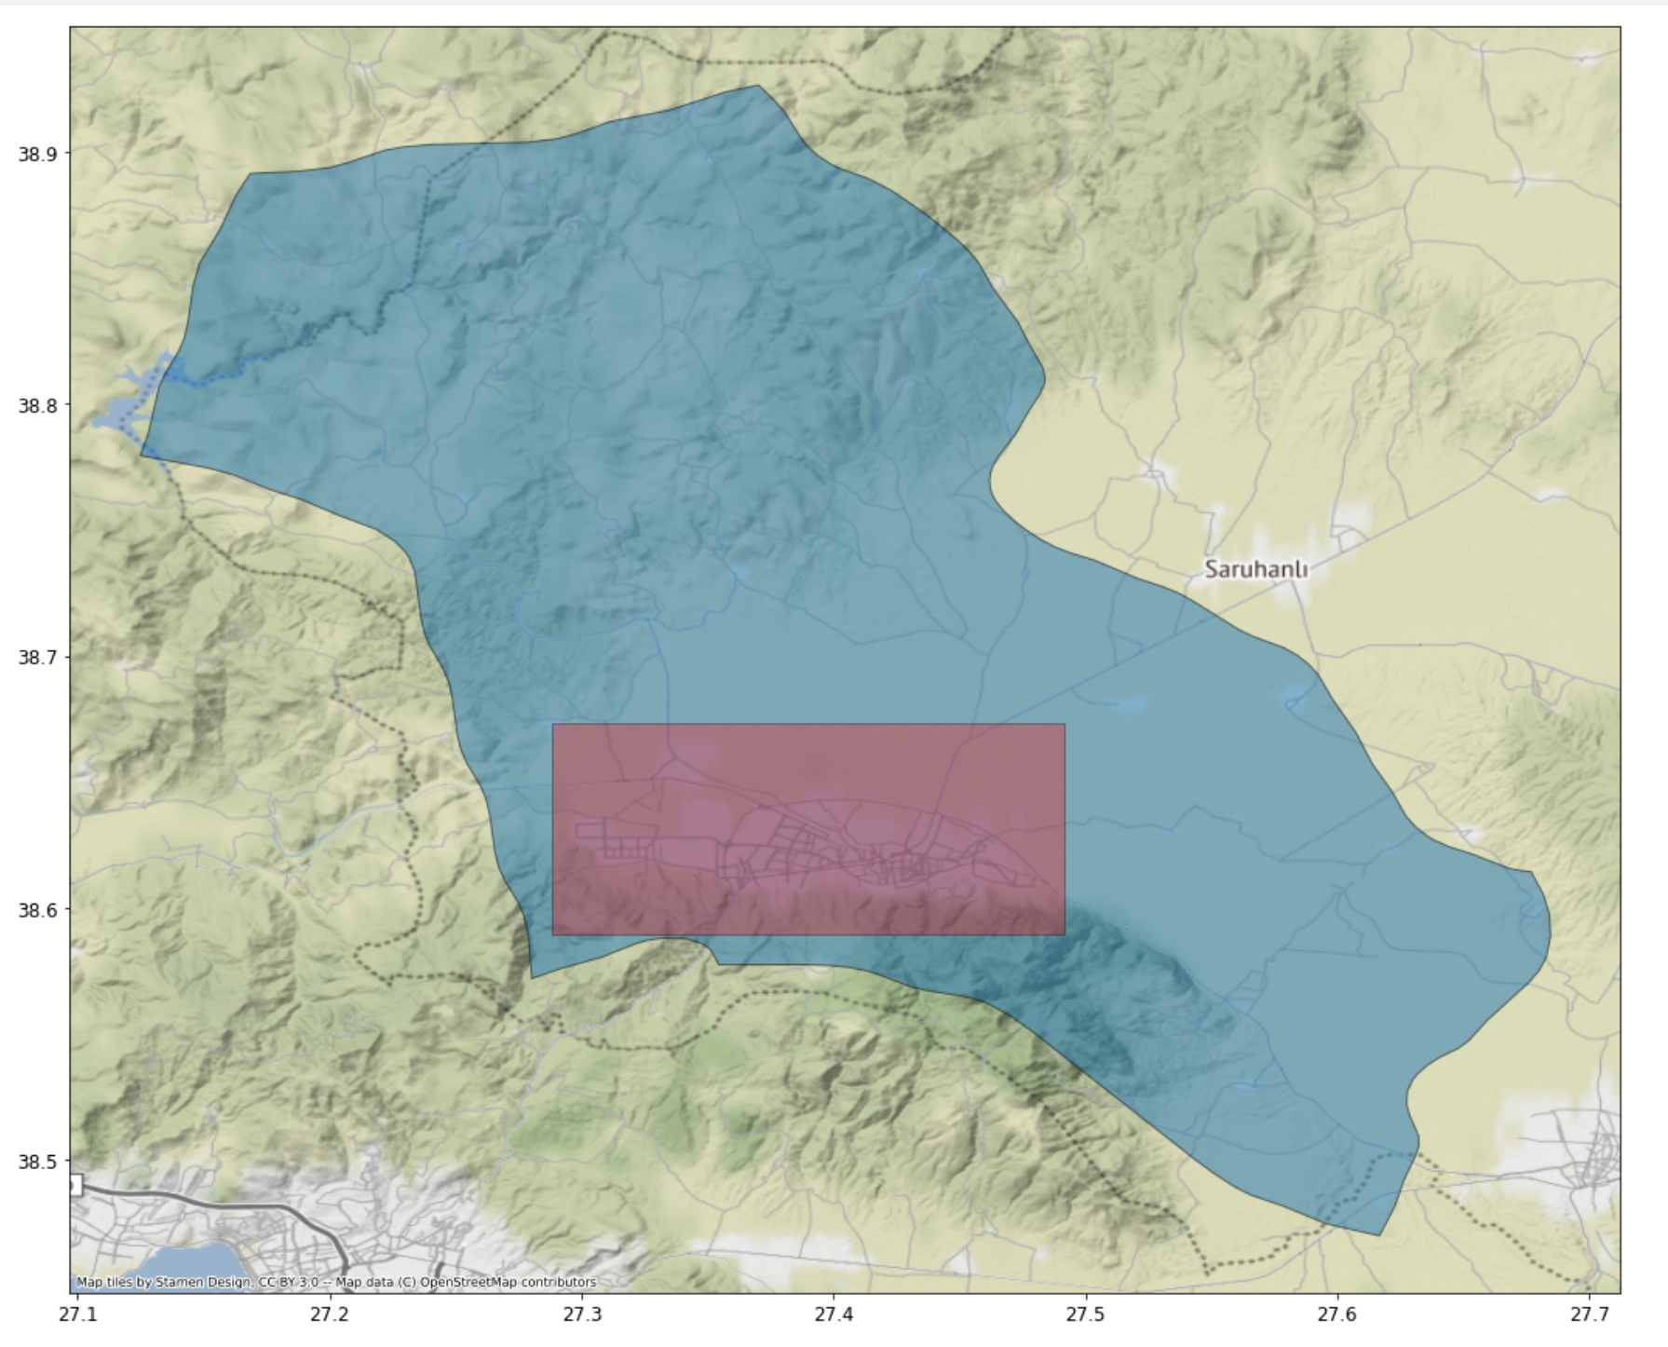
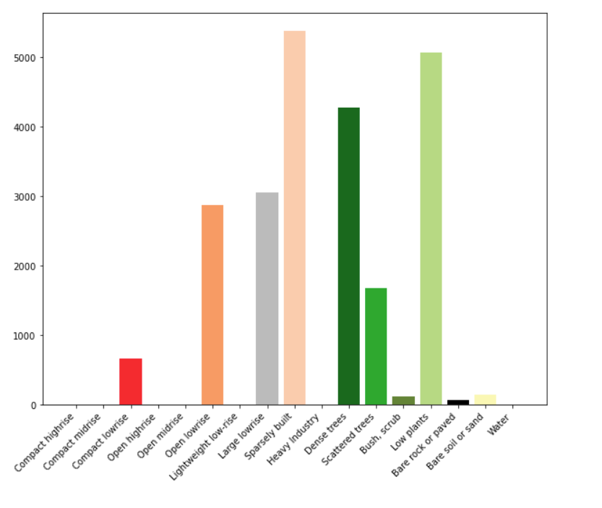
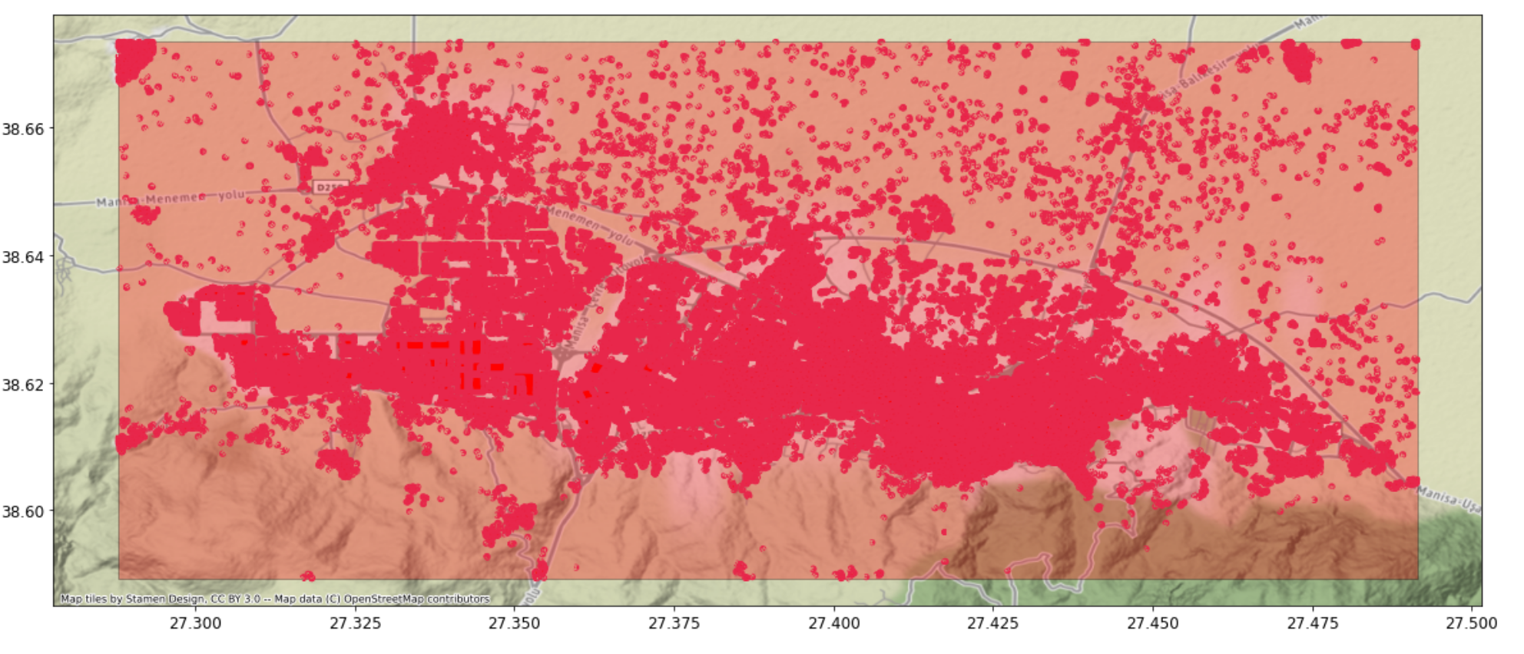
Manisa
(38.67, 27.28),
(38.58, 27.49)

Slide 10
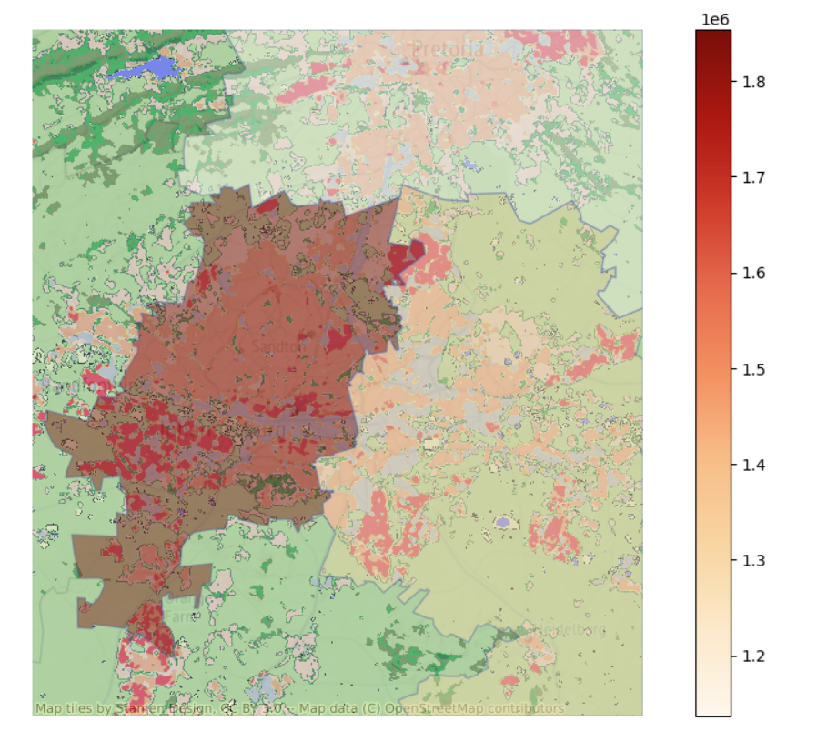
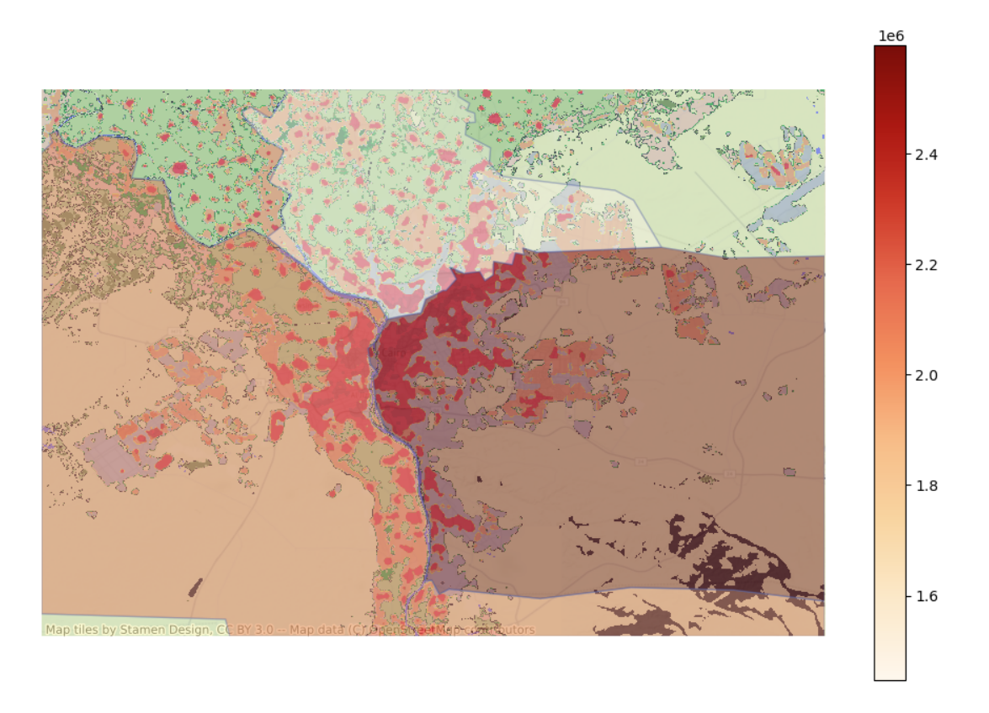
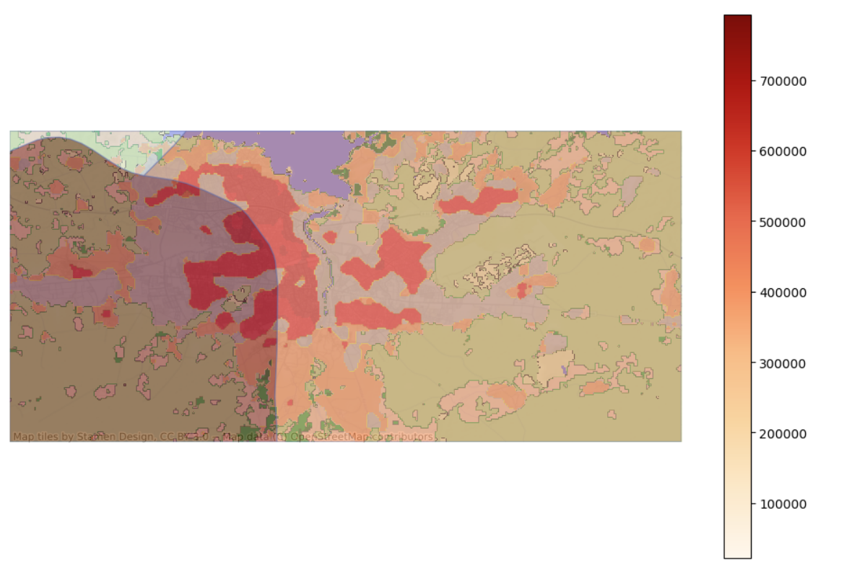
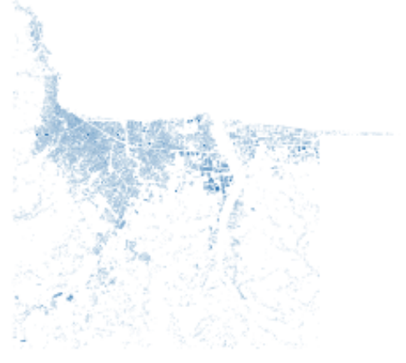

Slide 11
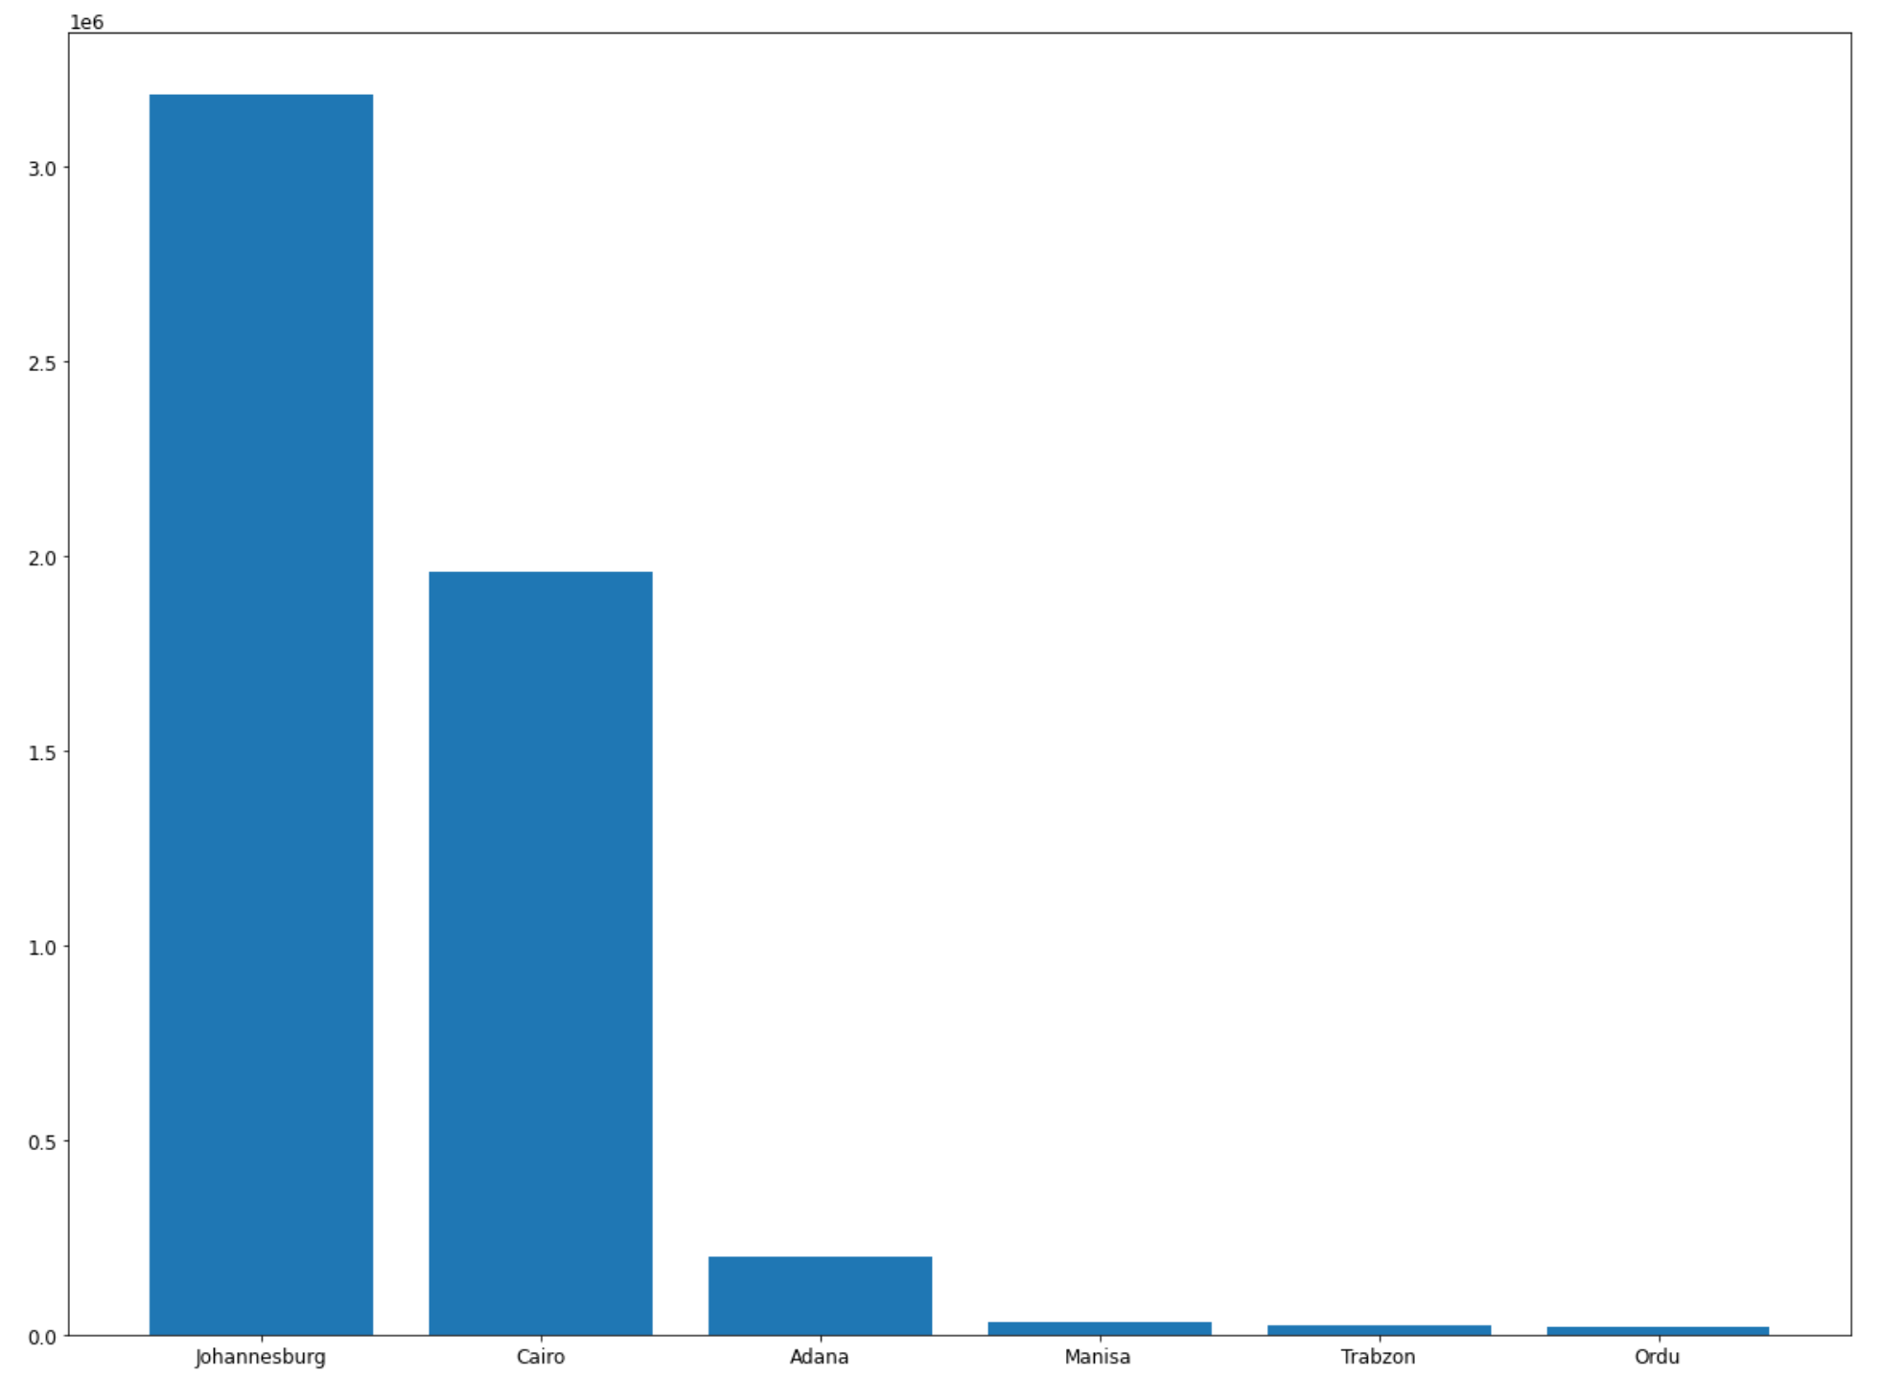
House numbers

Slide 12
Building Floor/Type Estimator
Microsoft database
(Polygenes only)
1. Compare the polygenes
If the polygenes from the two database can be matched, we can train a model with OSMB and predict on Microsoft database
2. Find out some other dataset that can be used as Feature
3. Build prediction model
X: Polygene, Landcover, radar, ladar, light,…
Y: Height, type
Training/testing: Open street map Buildings
Predicting: Microsoft database
Type1: Non-deep learning
We use each polygene as data sample
Type2: Deep learning
We use map tiles as data sample (we can random sample map tiles from target region as sample)
Open street map Buildings (OSMB)
(Polygene, height, type)
Landcover,
radar,
ladar,
Light, …
Activity Estimator
Total Emissions need to be assigned
Emission Multiplier
Naïve
f(pop, type)
CO2 Emission
Emission Factor
Population Density
f(area, floors, type)
Heating
Street Level
Satellite light image
f(pop, type, light)
Building Type
Electricity Usage
Miscellaneous
Map Grid
Based on other data source, TomTom, …
Activities

